Slide 1
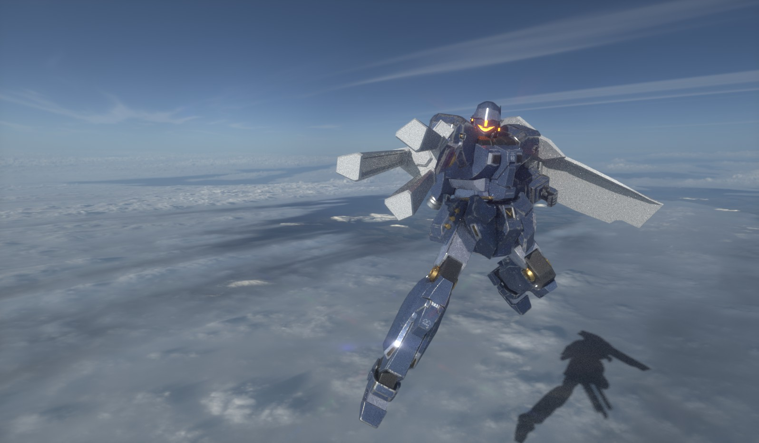
GAME ‘EXECUTOR’
Graduation Project Presentation
Presentation - Minsu Lim
Programing – Chanyoung Song, Seokhyee Kim
Grpahic design – GyoengGeuk Jang, Minsu Lim

Slide 2

Contents
Introduction
Changes
Final Goal

Slide 3
Contents
Introduction
Changes
Final Goal

Slide 4




Introduction
2018
2019
Mecha Action game?

Slide 5
Contents
Introduction
Changes
Final Goal

Slide 6
Contents
Introduction
Changes
Final Goal

Slide 7
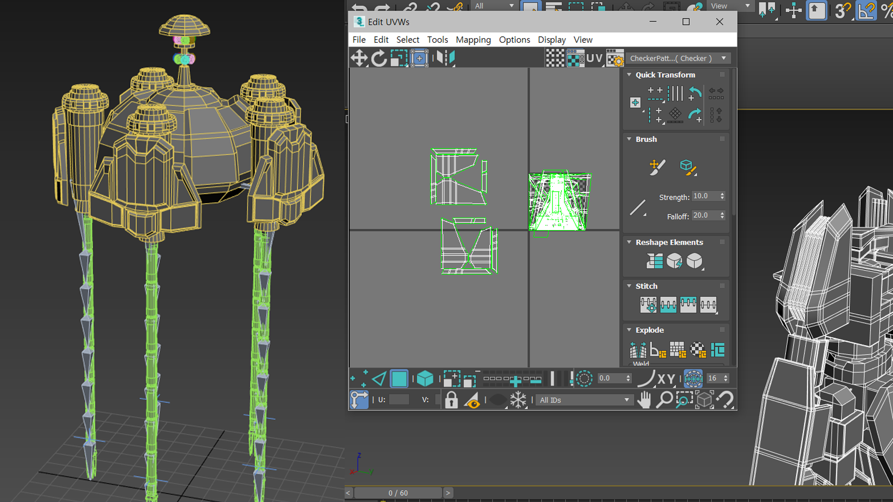


What did we change?
1st Test to 2nd Test

Slide 8
Contents
Introduction
Changes
Final Goal

Slide 9
Contents
Introduction
Changes
Final Goal

Slide 10
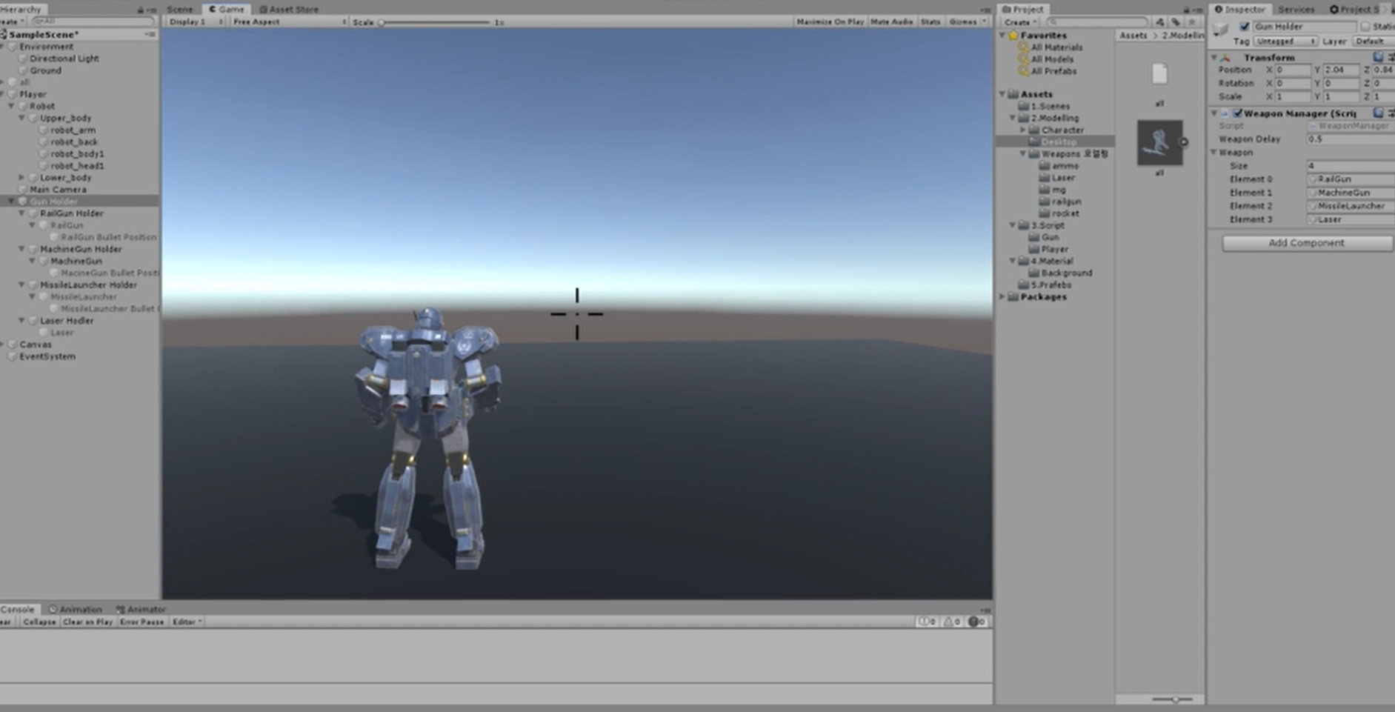


Final Goal
Focus on Detail
Exciting Experience
Realistic Sound
Compile to Play

Slide 11
Thanks for listening! | Question & Answers

